Slide 1
Natural Language Processing and
Speech Recognition

Slide 2
NLP Text Vectorization

Slide 3

Understand the concept of word vectors
Explain various word vectorization techniques
Understand creation of vectors using bag-of-words and TF-IDF techniques

Slide 4
Understanding Feature Vectors

Slide 5

What are Vectors?
A vector is a mathematical representation of a word or a sequence of words.
Given here are the frequency counts for the words 'classification' and 'evolution' in five distinct research papers.
 |  | Subject-Area of the research paper
 | Count of words | Machine Learning | History | Machine Learning | History | Machine Learning
Words
 | classification | 250 | 48 | 280 | 64 | 450
 | evolution | 50 | 280 | 30 | 380 | 12
Y
X
The subject areas covered in these research papers span Machine Learning and History.
Notes:
RGB : R-221, G-234, B-246

Slide 6

What are Vectors?
The research papers are plot based on the count of the words – classification and evolution.
This representation is used to capture the semantic meaning of words and their relationships in a numerical format.
This format can be easily processed by machine learning algorithms.
Machine learning
History

Slide 7
What are Vectors?
The research papers are plot based on the count of the words – classification and evolution.
Predictions can be made for any new research paper using the line separating the two types of research papers.
New paper
Machine learning
History

Slide 8
Word Analogies
Word analogies involve identifying relationships between words and then using these relationships to find missing or analogous words.
b
Woman
A word analogy is like saying "a is to b as x is to y”.
y
Queen
Man
This means that a and x can undergo similar changes to become b and y, and vice versa.
a
King
x

Slide 9
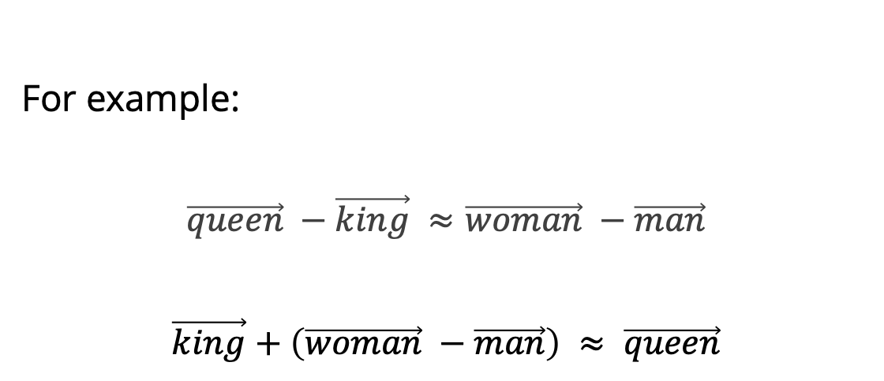
Word Analogies
Word analogies can often be solved using vector arithmetic.
Vector distance is used to find the closest match for a missing word in a word-pair.
Woman
royal
Queen
b
y
female
female
a
x
Man
royal
King

Slide 10
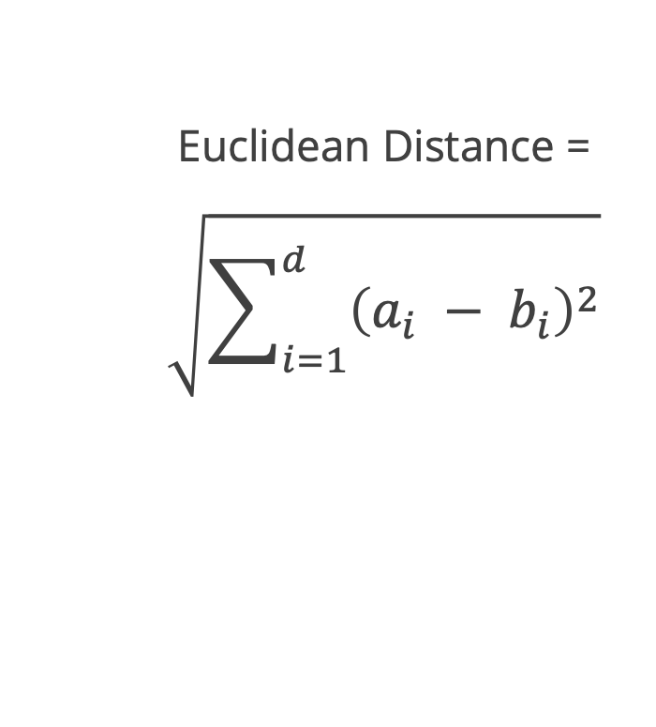
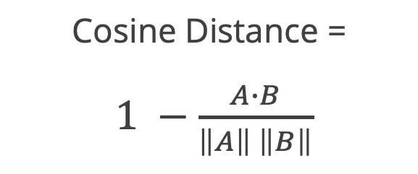
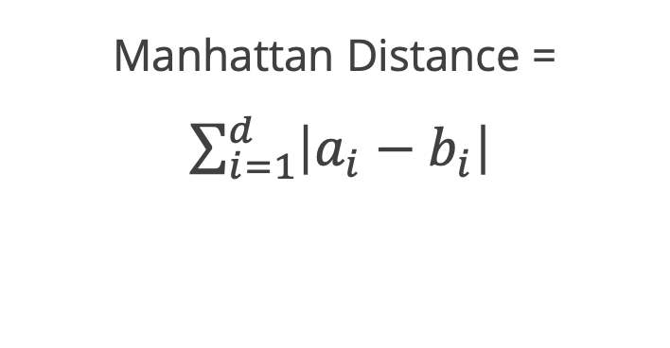
Distance Calculation
The distance measure between the word vectors enables the assessment of both similarities and differences between the words.
These distances can be measured as:

Slide 11
Text Vectorization Techniques
There are various techniques available for conversion of text to vector. Some of the most common techniques used include:
Bag of words
TF-IDF
Fundamental text vectorization techniques
N-grams
Word embeddings

Slide 12
One-Hot-Encoding

Slide 13
One-Hot-Encoding
One-hot encoding involves representing words or tokens in a text as binary vectors.
Treats each word in the vocabulary as a class or category
Assigns vector value 1 where the word is present and 0 at other places
This binary representation transforms of text data into a machine-learning-friendly format, enabling effective processing and analysis of categorical information by the model.

Slide 14
One-Hot-Encoding: Working
In one-hot encoding, the sparsity of the representation increases with a higher number of distinct categorical values.
Corpus (D) set of documents
I have a little daughter
Mary had a little lamb
Twinkle twinkle little star
The silence of lambs
Tokens
[ “little”, “daughter”]
[“mary”, “little”, “lamb”]
[“twinkle”, “little”, “star”]
[“silence”, “lambs”]
Text pre-processing
vocabulary
little | daughter | lamb | twinkle | star | silence | mary

Slide 15
One-Hot-Encoding: Working
Based on the vocabulary generated with the documents, shown below is the one hot encoded matrix for the sentence:
“Mary had a little lamb.”
 |  | Vocabulary
 |  | little | daughter | lamb | twinkle | star | silence | mary
Tokens | mary | 0 | 1 | 0 | 0 | 0 | 0 | 1
 | little | 1 | 0 | 0 | 0 | 0 | 0 | 0
 | lamb | 0 | 0 | 1 | 0 | 0 | 0 | 0

Slide 16
One-Hot-Encoding
In one-hot encoding, the sparsity of the representation increases with a higher number of distinct categorical values.
As the vocabulary size increases, these one hot encoded vectors become larger and sparser.
The high dimensionality and sparsity contribute to increased memory requirements, affecting storage efficiency.
This can lead to inefficiencies in terms of storage, computation, and training times.

Slide 17
Bag-of-Words

Slide 18
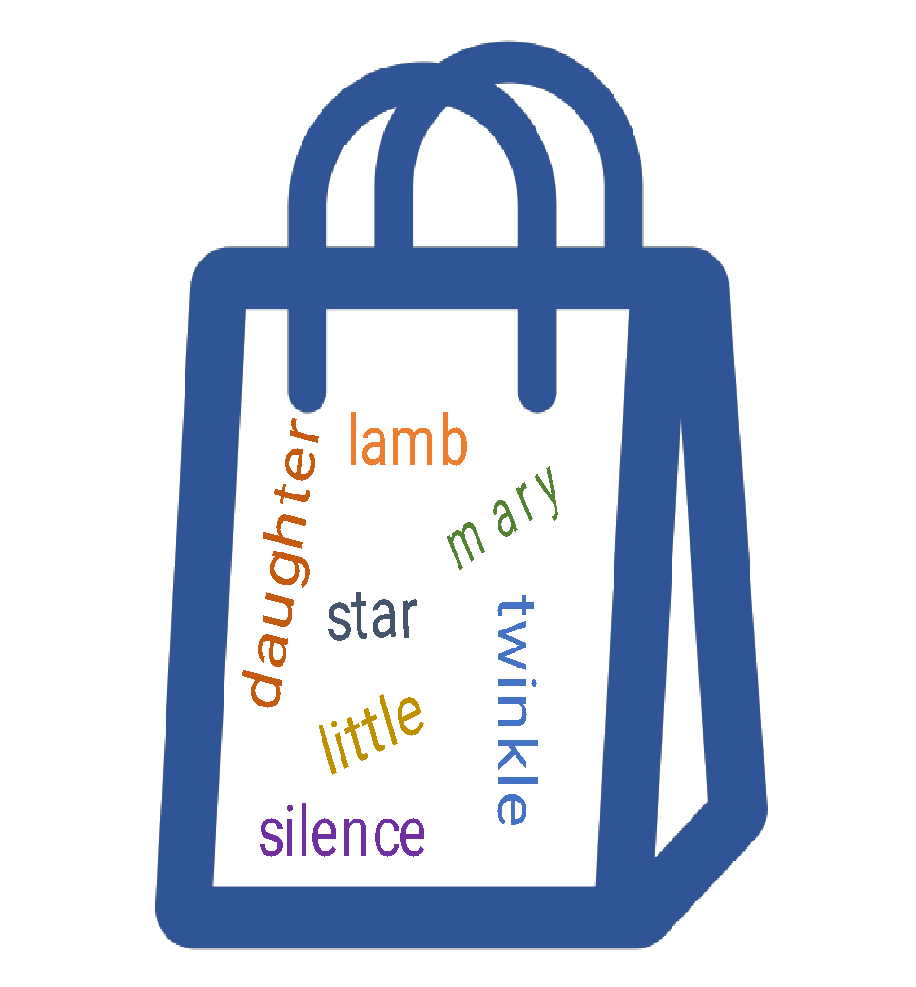

Bag-of-Words
A "bag of words" (BoW) is a representation of a text that describes the occurrence of words within a document.
Processed Data
Unordered collection of words
The bag-of-words model extracts features from text to represent the data. It models the text using a machine learning algorithm.

Slide 19
Bag-of-Words
Bag of words is a simple and widely used technique for feature extraction in various NLP tasks.
1
2
3
The method is called “bag-of-words,” as the order of the words is lost entirely
It has no effect of grammar and order of words in the sentence
It is a vectorization technique utilized to perform document level tasks

Slide 20
Bag-of-Words
Bag-of-words involves following steps:
Tokenization
While creating the bag of words, tokenized word of each observation is used
Process
These tokenized words are used to create a vocabulary by listing all unique words
Scoring mechanism
Document vectors are created using scoring mechanism that include word hashing or boolean value scoring

Slide 21
Bag-of-Words: Example
Working with the same vocabulary from the previous (one-hot-encoding) section:
Corpus (D) Set of Documents
I have a little daughter
Mary had a little lamb
Twinkle twinkle little star
The silence of lambs
Vocabulary
little | daughter | lamb | twinkle | star | silence | mary

Slide 22
Bag-of-Words: Example
Shown below is the the document matrix using bag of words. The matrix has been generated using the term frequency scoring.
 | little | daughter | lamb | twinkle | star | silence | mary
I have a little daughter | 1 | 1 | 0 | 0 | 0 | 0 | 0
Mary had a little lamb | 1 | 0 | 1 | 0 | 0 | 0 | 1
Twinkle twinkle little star | 1 | 0 | 0 | 2 | 1 | 0 | 0
The silence of lambs | 0 | 0 | 1 | 0 | 0 | 1 | 0
Term Frequency

Slide 23
Bag-of-Words: Recap of Terms Used
Term
Term Frequency
Each processed word is called term
Frequency of a term-occurrence in a document
Term Matrix
Matrix showing frequency of each term-occurrence in documents

Slide 24
TF-IDF

Slide 25
TF-IDF
Bag-of-Words assumes that each word is equally important. However, in real-world scenario, each word has its own weight based on the context.
For instance, the term cost might occur more frequently in an economy related document.
In such cases, TF-IDF is more helpful as it assigns weights to the words based on their relevance in the document.

Slide 26
TF-IDF
Term Frequency-Inverse Document Frequency or TF-IDF, is a numerical statistic that reflects the importance of a word in a document relative to a collection of documents.
Term Frequency
Inverse Document Frequency
TF-IDF
Measures how important a term is across a collection of documents
Measures how often a term (word) appears in a document

Slide 27
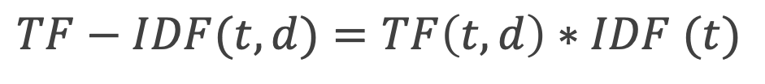
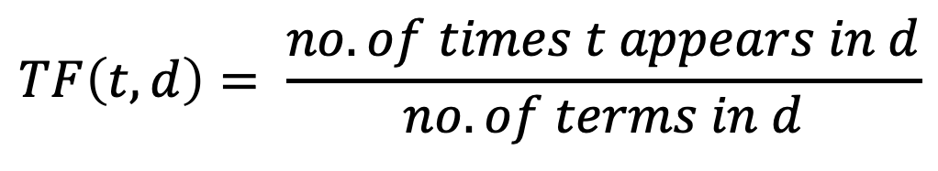
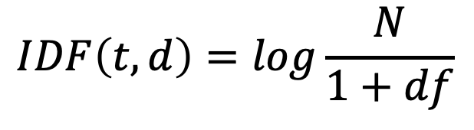
TF-IDF
TF-IDF score for a term in a document is the product of its TF and IDF values.
TF (t,d) is term frequency of term t in document d
IDF(t) is inverse document frequency of term t
Refer to jupyter notebook for examples.

Slide 28
Word vectorization is used to capture the semantic meaning of words and their relationships in a numerical format.
The distance measure between the word vectors enables the assessment of both similarities and differences between the words.
Various techniques used for word vectorization include one-hot-encoding, bag of words and TF-IDF.

Slide 30
Which technique represents a document as an unordered set of words, ignoring grammar and word order?
1
Word embeddings
Bag-of-words
TF-IDF
Word2Vec

Slide 31
Which technique represents a document as an unordered set of words, ignoring grammar and word order?
1
Word embeddings
Bag-of-words
TF-IDF
Word2Vec
B
The method is known as bag-of-words, as the order of the words is lost entirely.

Slide 32
Which word vectorization technique is more effective in capturing the importance of rare words in a document?
2
TF-IDF
Bag-of-words
Word embeddings
Word2Vec

Slide 33
Which word vectorization technique is more effective in capturing the importance of rare words in a document?
2
TF-IDF
Bag-of-words
Word embeddings
Word2Vec
A
TF-IDF is more effective in this scenario, as it assigns weights to the words based on their relevance in the document.

Slide 34
In TF-IDF, what is the purpose of the IDF component?
3
Captures word frequency in a document
Considers the importance of words across documents
Measures the length of words
Represents word semantics

Slide 35
In TF-IDF, what is the purpose of the IDF component?
3
Captures word frequency in a document
Considers the importance of words across documents
Measures the length of words
Represents word semantics
A
Inverse Document Frequencies (IDF) considers the importance of words across documents.

Slide 36
Thank You!

